Slide 1
awk

Slide 2
awk
Programming language
POSIX spec
Originated @ AT&T Bell Labs in 1977
Aho, Weinberger, & Kernighan

Slide 3
awk
Features
User-defined functions
Multiple input streams
TCP/IP networking access
Rich set of regular expressions

Slide 4
awk
Many tasks can be done with AWK:
Text processing
Producing formatted text reports
Performing arithmetic operations
Performing string operations, and many more

Slide 5
awk
At its most basic, awk searches files for some unit of text (usually lines terminated with an end-of-line character) containing some user-specified pattern
When a line matches one of the patterns, awk performs some set of user-defined actions on that line, then processes input lines until the end of the input files

Slide 6
awk
awk is used as a command as often as it is used as an interpreted script
One-liners are popular and useful ways of filtering output from files or output streams or as standalone commands

Slide 7
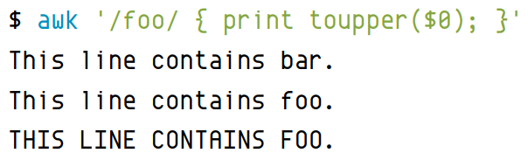
awk
awk even has an interactive mode of sorts because, without input, it acts upon any line the user types into the terminal:

Slide 8
awk
POWERFUL text-parsing tool for Unix and Unix-like systems
Because it has programmed functions that you can use to perform common parsing tasks, it’s also considered a programming language

Slide 9
awk
You probably won’t be developing your next GUI application with awk, and it likely won’t take the place of your default scripting language, but it’s a powerful utility for specific tasks
What those tasks may be is surprisingly diverse
The best way to discover which of your problems might be best solved by awk is to learn awk; you’ll be surprised at how awk can help you get more done but with a lot less effort

Slide 10
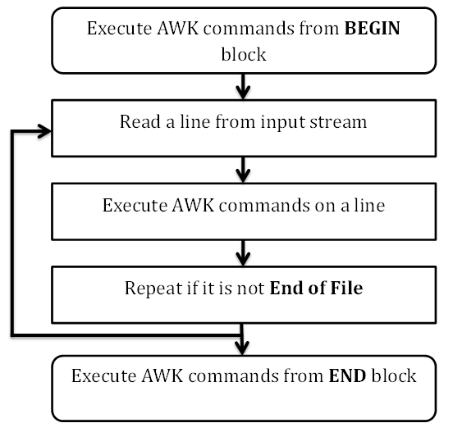
awk - Workflow

Slide 11
awk - Workflow
Read
AWK reads a line from the input stream (file, pipe, or stdin) and stores it in memory.
Execute
All AWK commands are applied sequentially on the input. By default, AWK execute commands on every line. We can restrict this by providing patterns
Repeat
This process repeats until the file reaches its end

Slide 12
awk - Structure
BEGIN block
BEGIN {awk-commands}
The BEGIN block gets executed at program start-up
Executes only once
Good place to initialize variables
BEGIN is an AWK keyword and hence it must be in upper-case
Optional

Slide 13
awk - Structure
Body block
/pattern/ {awk-commands}
Applies AWK commands on every input line
AWK executes commands on every line
We can restrict this by providing patterns
No keywords for the Body block

Slide 14
awk - Structure
END block
END {awk-commands}
Executes at the end of the program
END is an AWK keyword
Must be in upper-case
Optional

Slide 15
awk
Basic syntax:

Slide 16
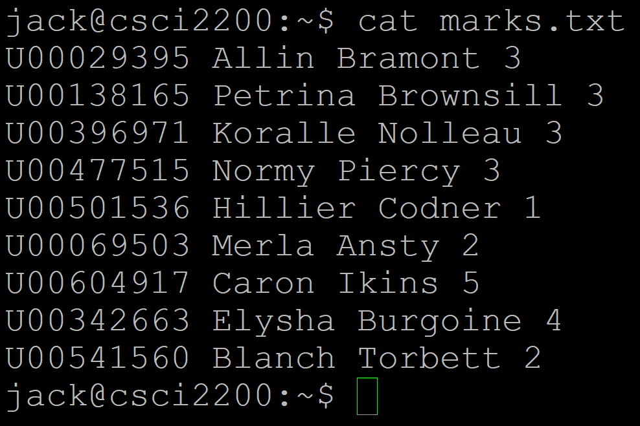
awk - Sample File

Slide 17
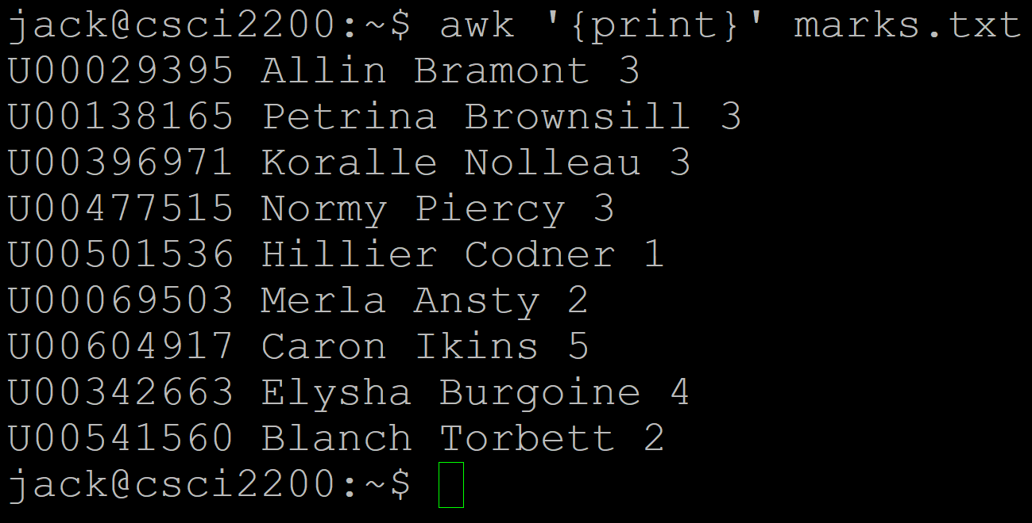
awk in Action

Slide 18
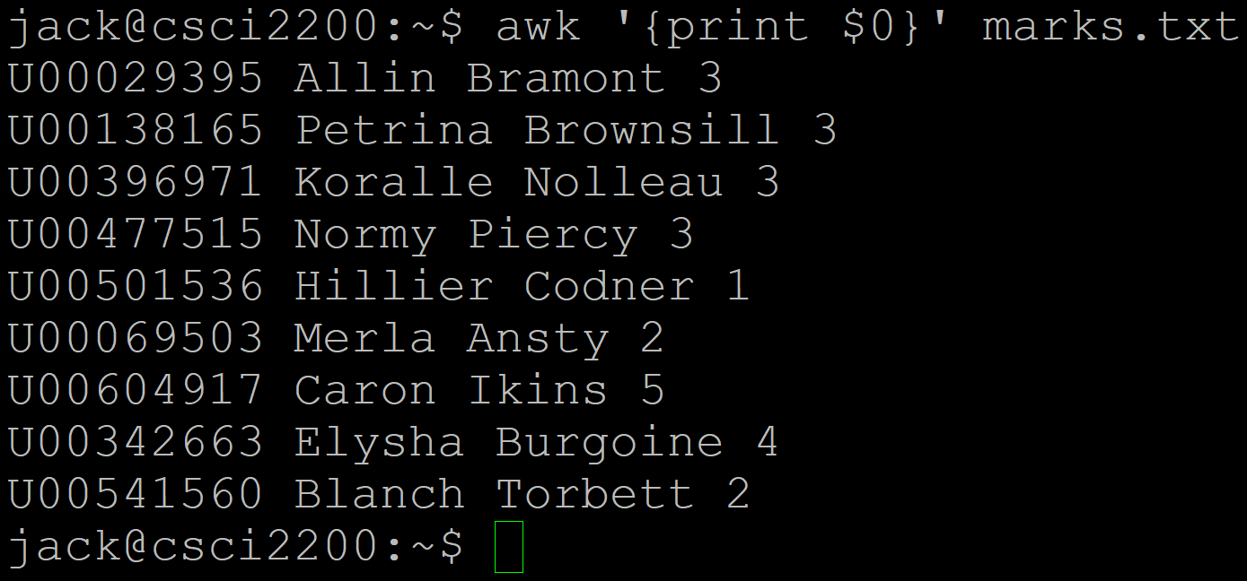
awk in Action

Slide 19
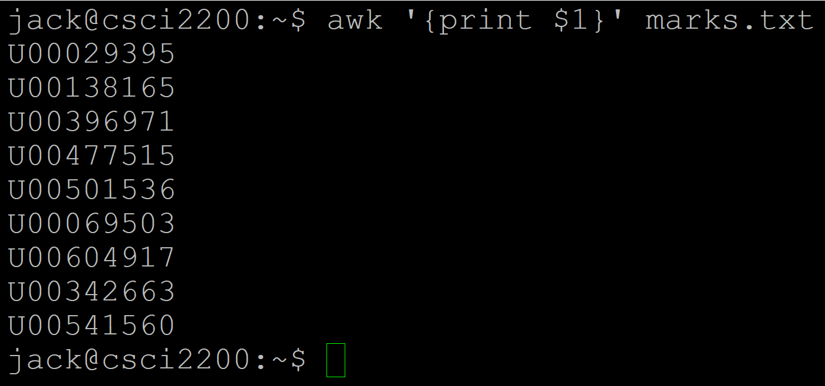
awk in Action

Slide 20
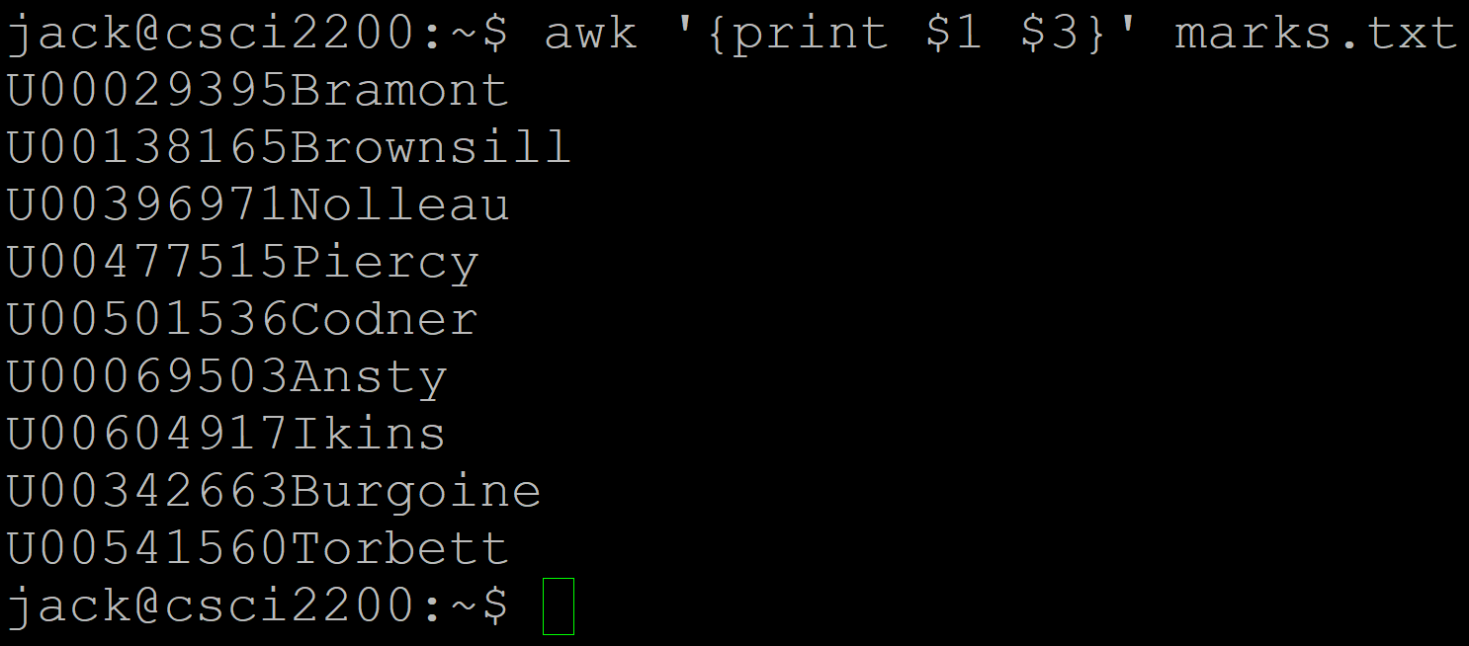
awk in Action

Slide 21
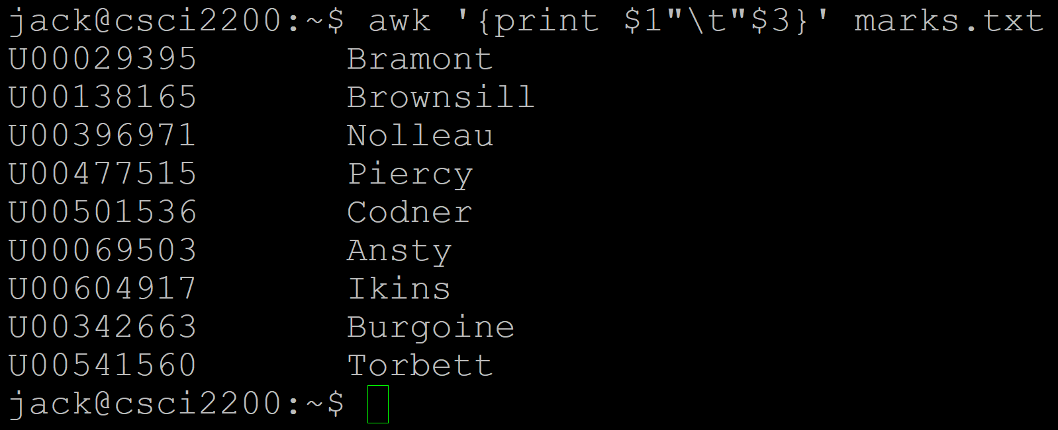
awk in Action

Slide 22
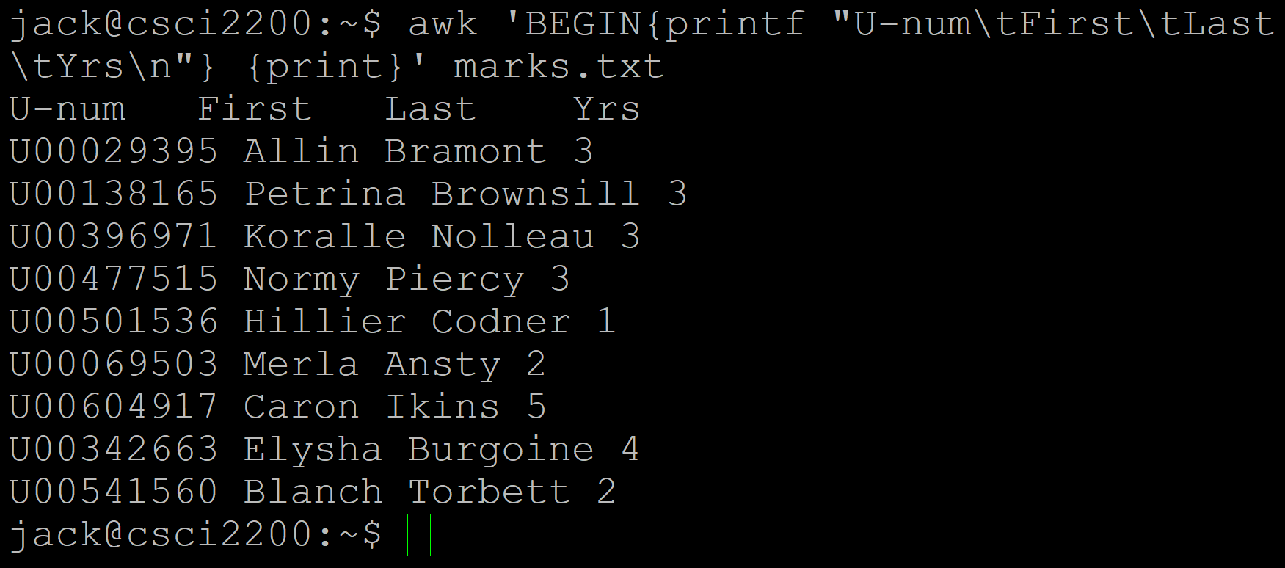
awk in Action

Slide 23
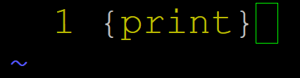
awk - Program File
We can save & run awk commands from a file
Syntax:
awk [options] -f file <filename>
Let’s create a text file, command.awk ->

Slide 24
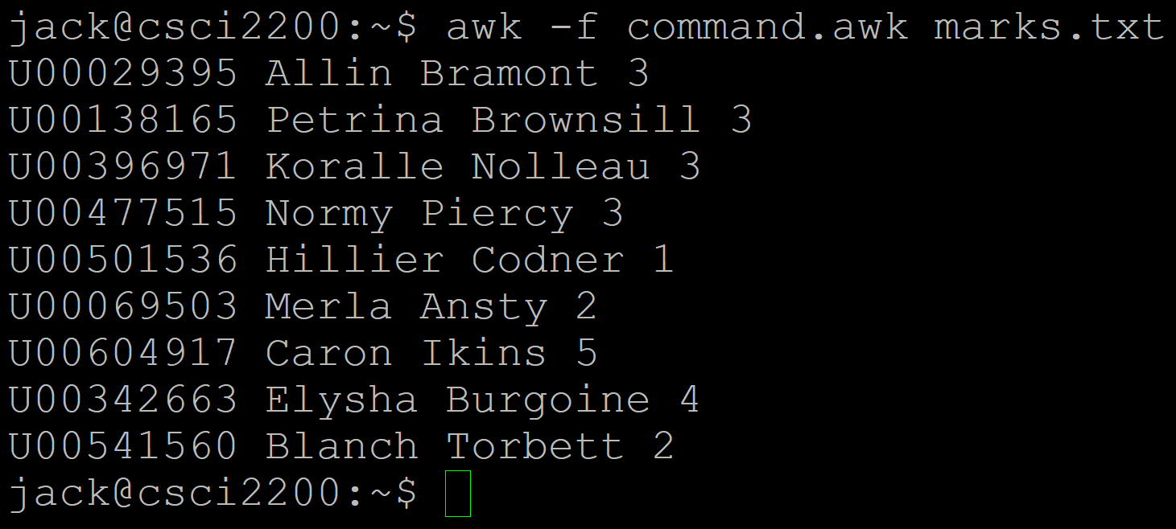
awk - Program File

Slide 25
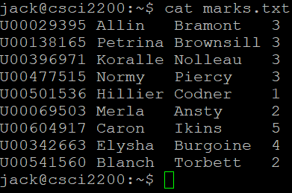
awk - Something else to notice
Remember how we had to deal with files that had differing numbers of spaces between fields?
awk automatically compresses the spaces for us
No need for tr -s " "
I edited marks.txt:

Slide 26
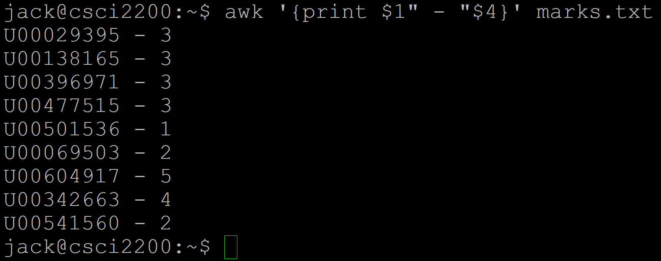
awk - Something else to notice

Slide 27
awk - Something else to notice
So, even though there were differing numbers of spaces between the last name and years enrolled fields, awk automatically compresses them
…down to none, as it happens, unless we specify something different

Slide 28
awk - Basic Pattern Matching
We can specify a pattern (regex) to match selected lines of a file
The pattern appears between / … / characters
awk '/pattern/ {command(s)' file

Slide 29
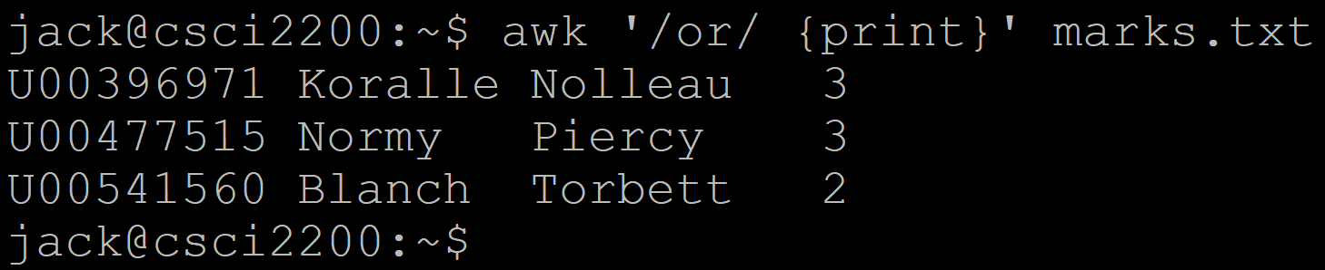
awk - Basic Pattern Matching
Here, we’re searching for lines that have the letters ‘or’ appearing in them

Slide 30
awk - Basic Pattern Matching
Having matched the patterns in lines, we can then filter the output
This can be a bit confusing (it was for me), if the field that matched is not actually output

Slide 31
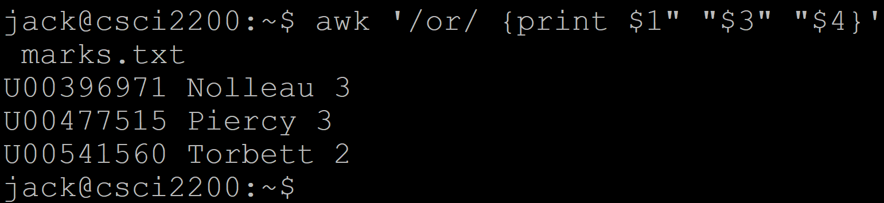
awk - Basic Pattern Matching
Even though the first two lines of the output don’t actually show the letters ‘or’, their lines still matched

Slide 32
awk
By the way, we can print the columns in any order

Slide 33
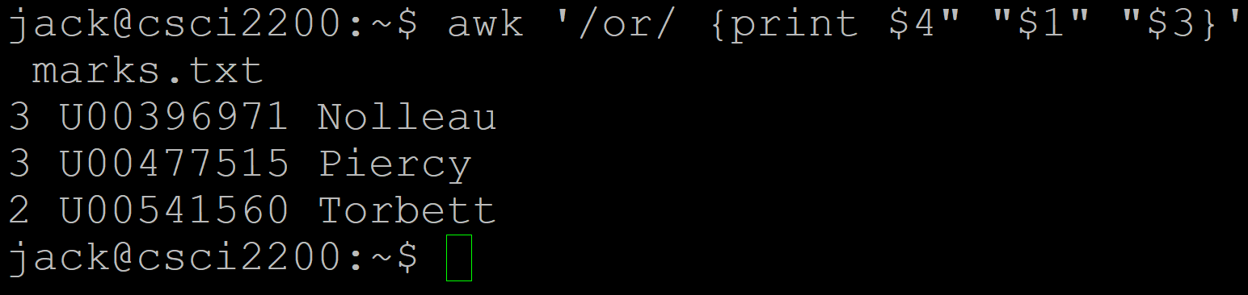
awk - Basic Pattern Matching
Lots easier than backreferencing!

Slide 34
awk - Counting Pattern Matches
Remember grep -c?
We can do the same thing with awk
awk '/pattern/{++cnt} END {print "Count = ", cnt}' marks.txt

Slide 35
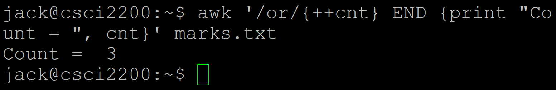
awk - Basic Pattern Matching
A little more convoluted that “-c”, but potentially useful
For one thing, we can combine display of the matching fields with the count

Slide 36
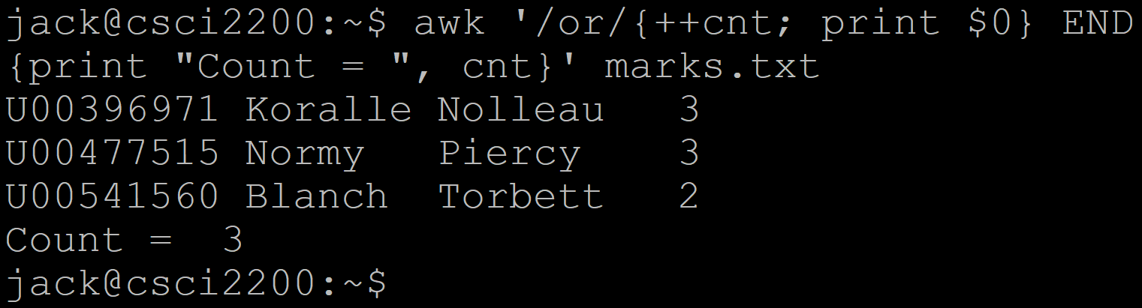
awk - Basic Pattern Matching
Notice here that we included two commands in the Body part of awk, separated by a semicolon

Slide 37
awk - length()
We can filter lines (or fields) by length using the built-in length function
awk 'length(field) <comparison> <number>' <file>

Slide 38
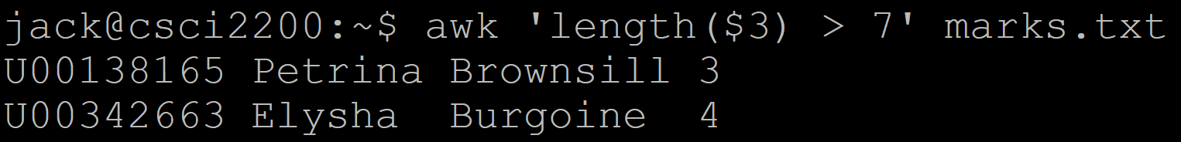
awk - length()
This checks the third (last name) field’s length and displays the record if it is greater than 7 characters

Slide 39
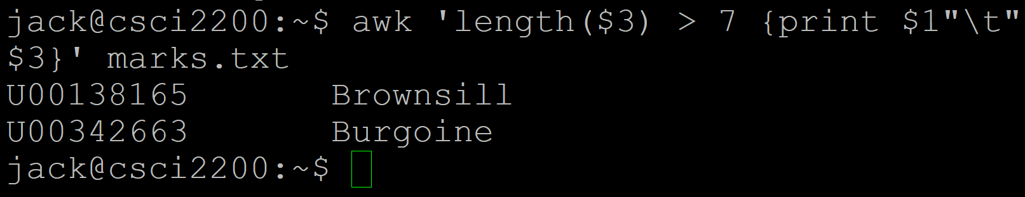
awk - length()
We can then filter the output line as desired

Slide 40
Built-in variables

Slide 41
awk - Built in Variables
There are several useful built-in variables (like environment variables) with awk
ARGC # of arguments ARGV array that stores command-line arguments FILENAME current file name FS field separator (can change with -F) NF # of fields in current record NR # of the current record OFS output field record ORS output record separator (default is \n)

Slide 42
awk - Built in Variables
There are several useful built-in variables (like environment variables) with awk
RS input record separator (default is \n) RSTART first position in string matched by match() function $0 entire input record (that’s a zero) $n field number

Slide 43
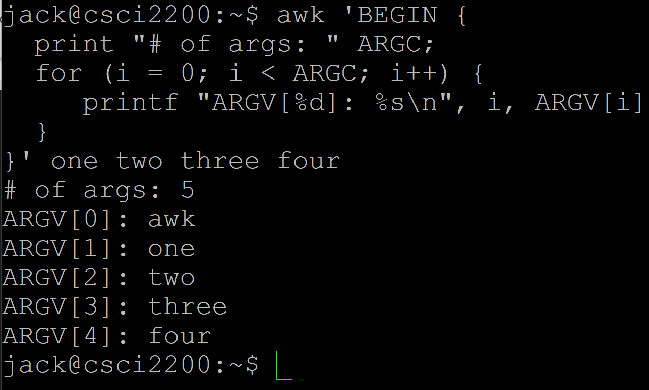
awk - Built in Variables

Slide 44
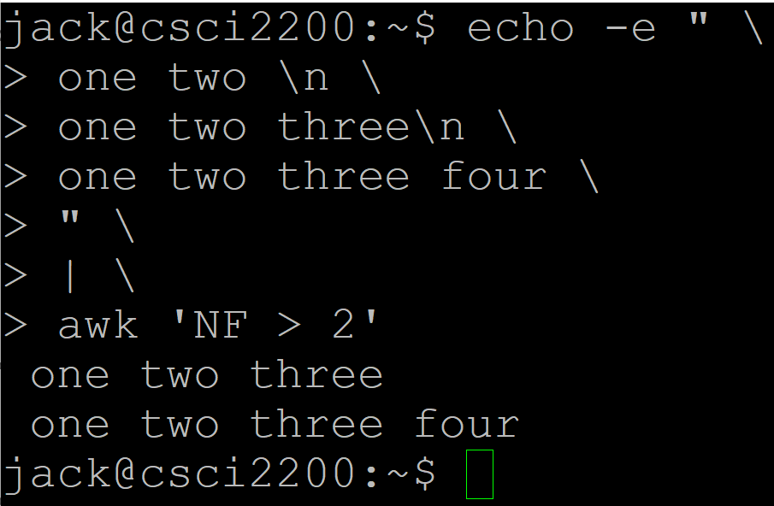
awk - Built in Variables

Slide 45
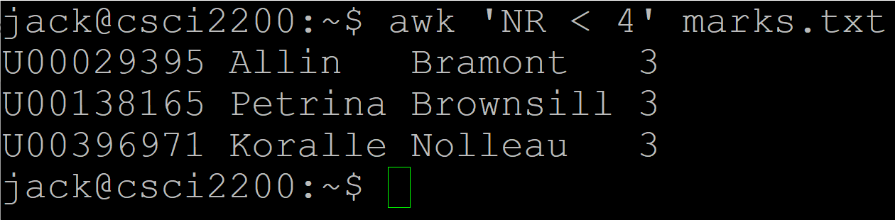
awk - Built in Variables

Slide 46
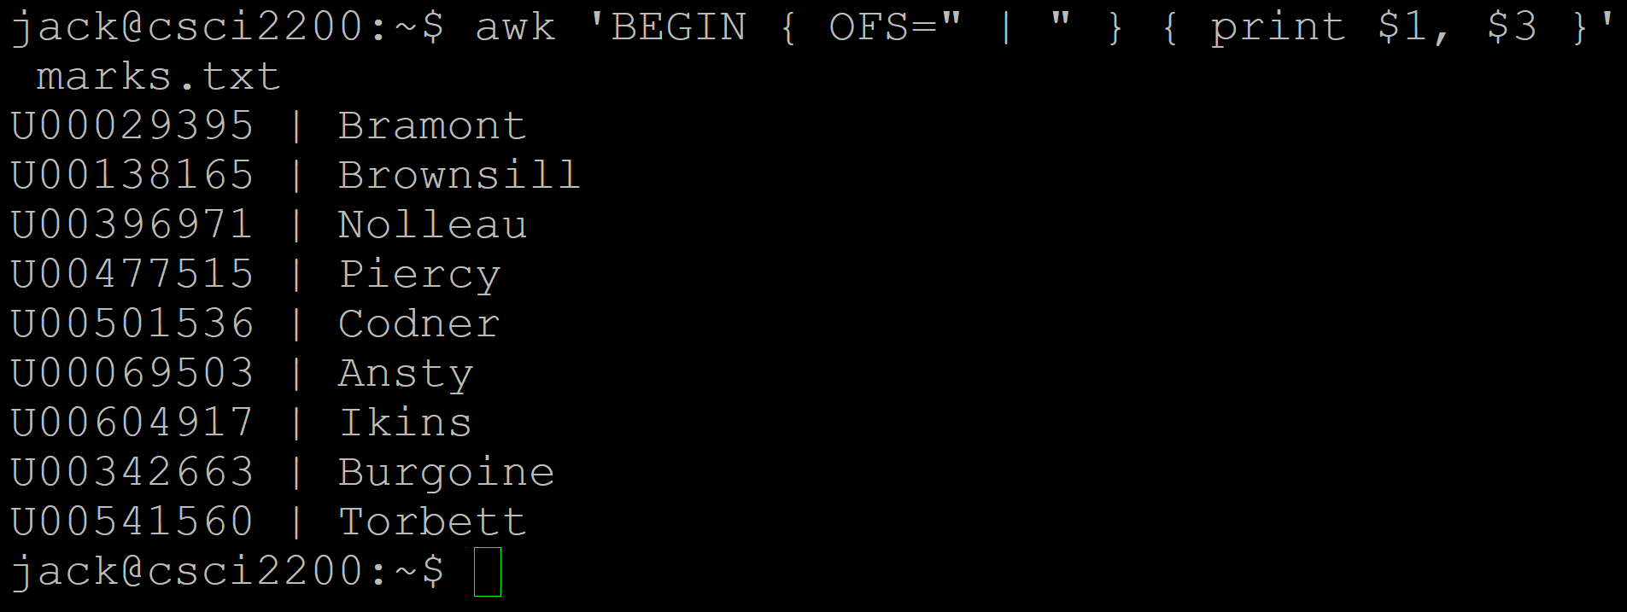
awk - Built in Variables

Slide 47
awk - Operators
awk supports the usual operators
Arithmetic Increment/decrement Assignment Relational Logical Ternary Exponential String concatenation Arrays Regex

Slide 48
Operators

Slide 49
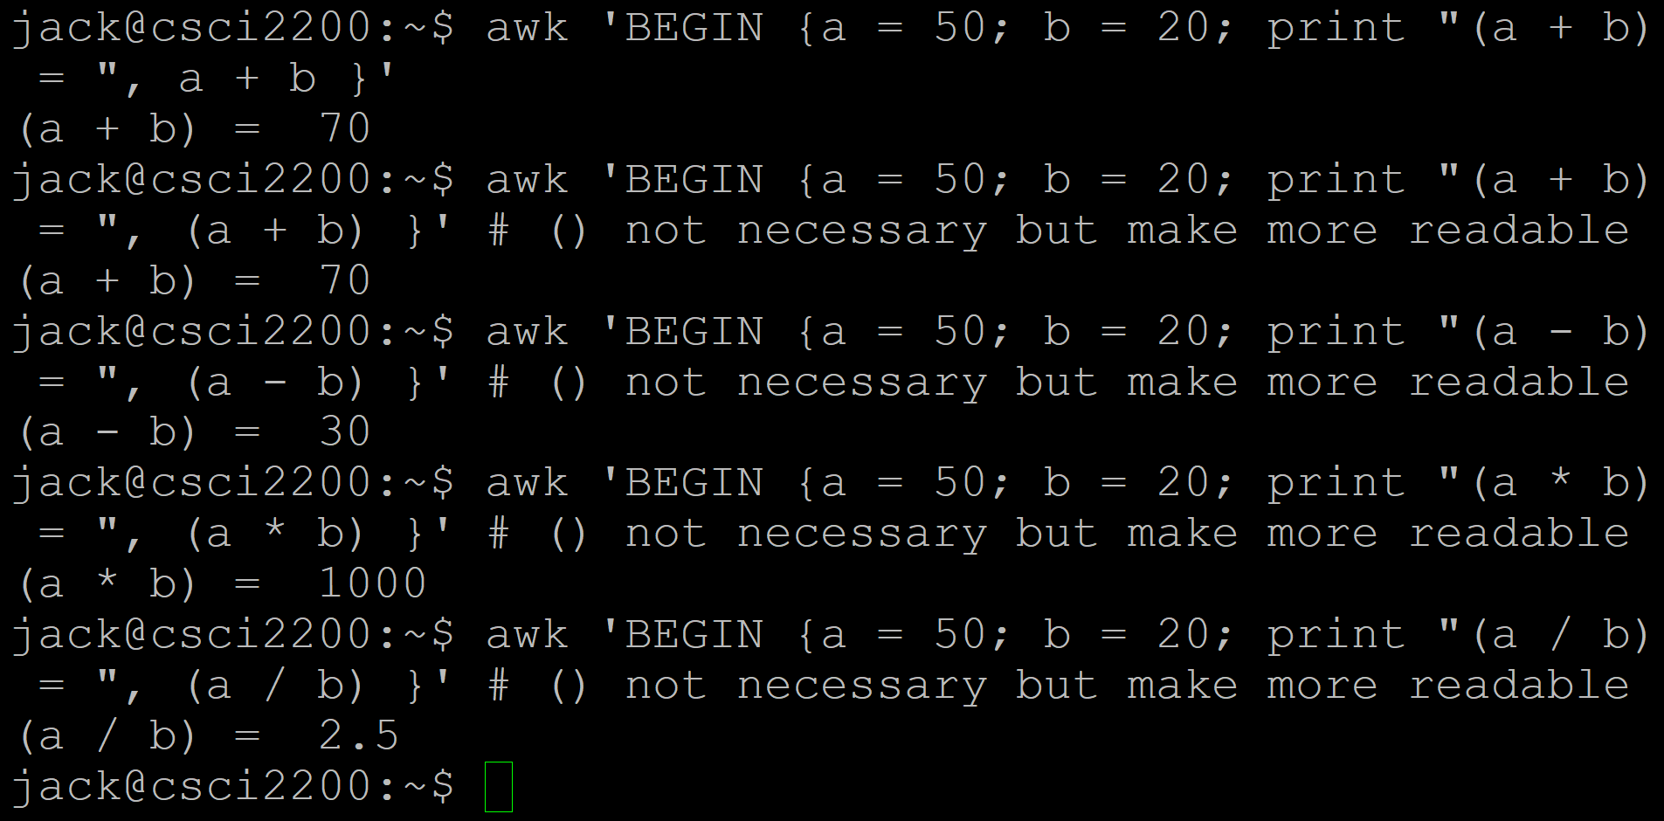
awk - Operators (Arithmetic)

Slide 50
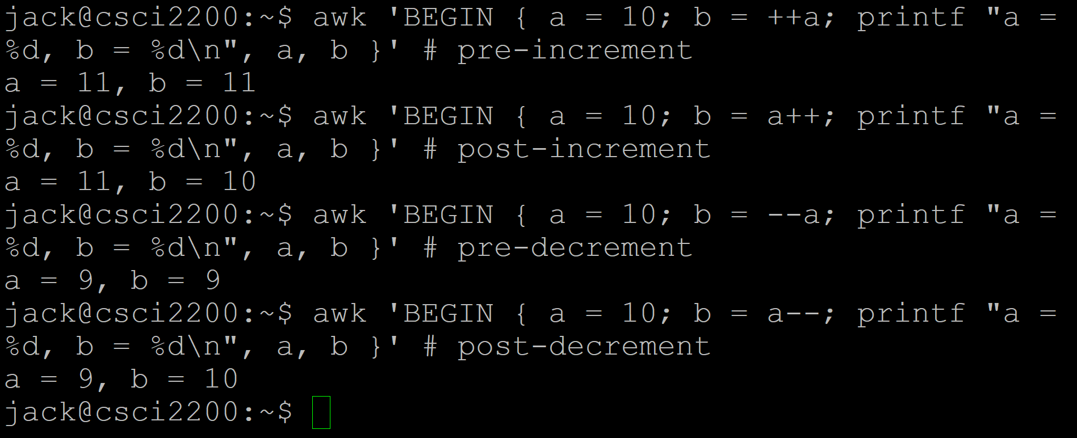
awk - Operators (Increment/Decrement)

Slide 51
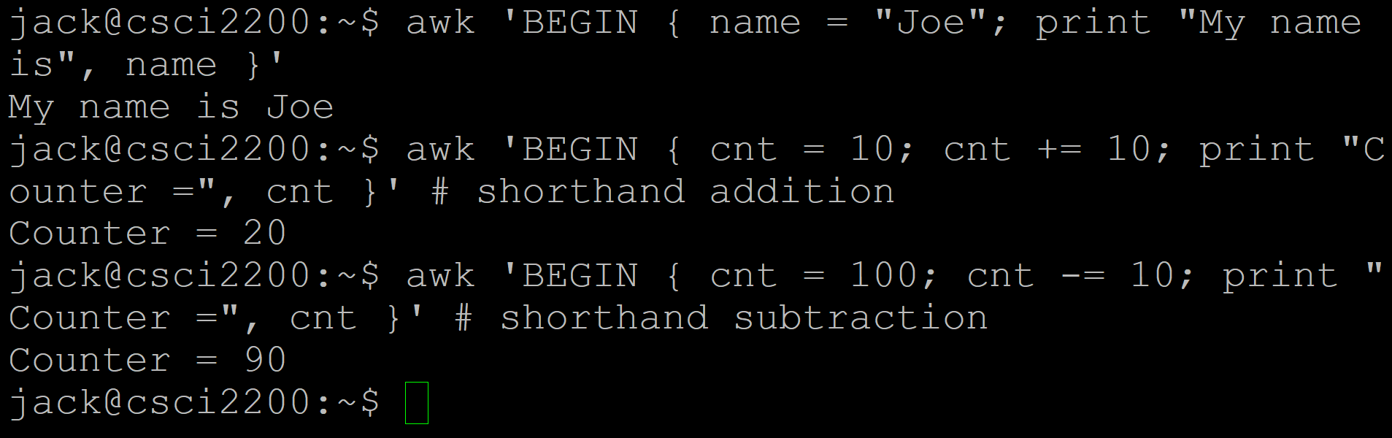
awk - Operators (Assignment)

Slide 52
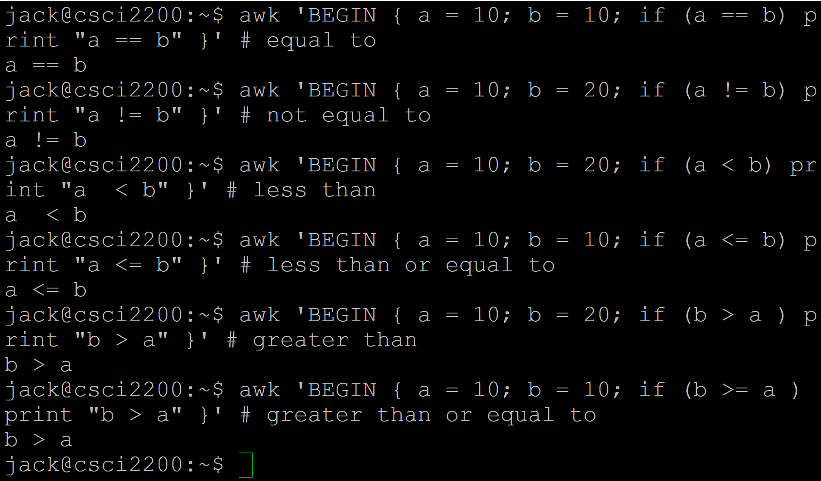
awk - Operators (Relational)

Slide 53
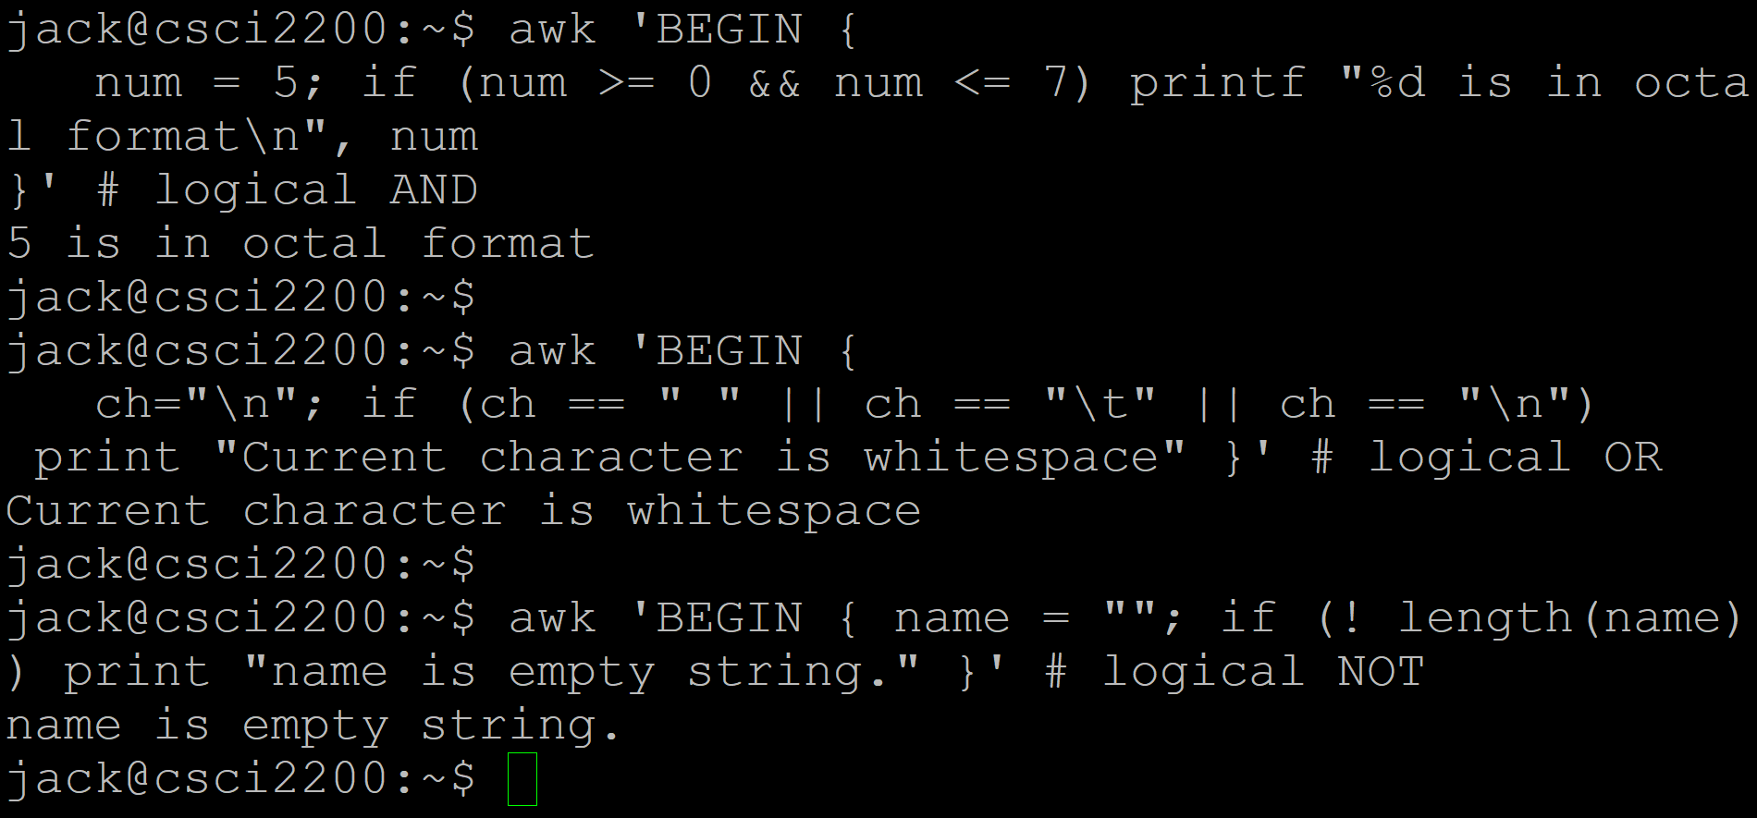
awk - Operators (Logical)

Slide 54
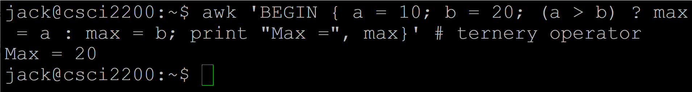
awk - Operators (Ternary)

Slide 55
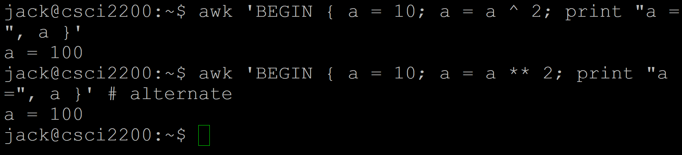
awk - Operators (Exponential)

Slide 56
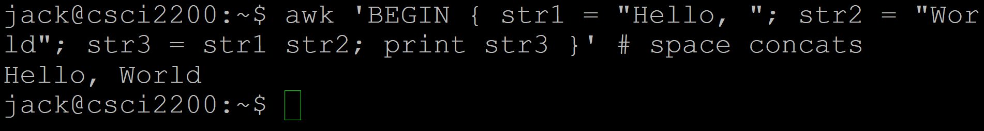
awk - Operators (String Concatenation)

Slide 57
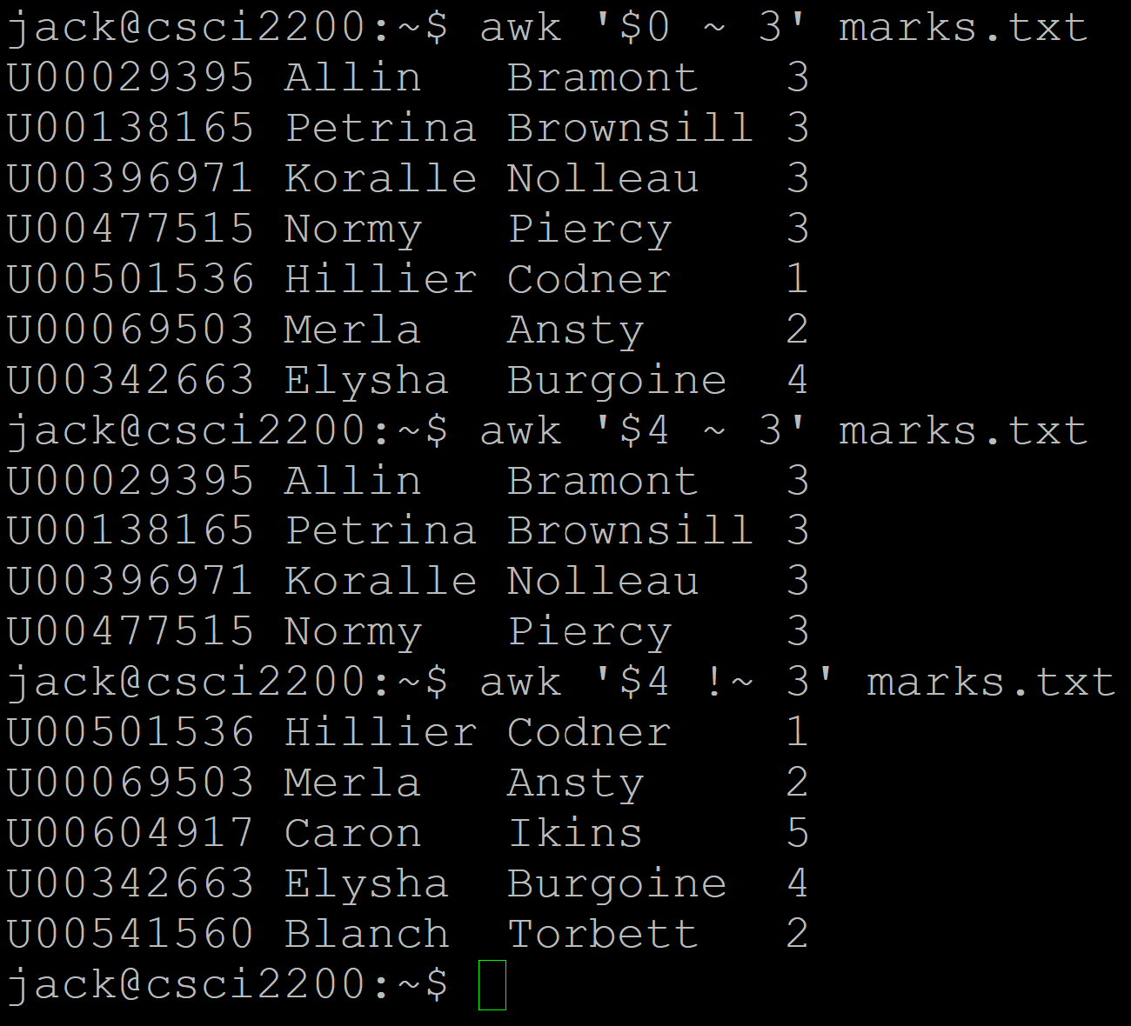
awk - Operators (Regex Operators)
‘~’ means ‘contains’
So, ‘$0 ~ 3’ means, “the current line ($0) contains ‘3’”
‘$4 ~ 3’ means, “the fourth field ($4) contains ‘3’”

Slide 58
More regex

Slide 59
awk - Regex
The regex rules and patterns we’ve already learned can be used with awk as well
Special characters (‘.’, ‘*’, ‘?’, ‘+’) all work the same way
awk supports PCRE ([…], {…}, etc.) and POSIX ([[:…:]]) notation

Slide 60
awk
For now, let’s round out today’s discussion with a few examples

Slide 61
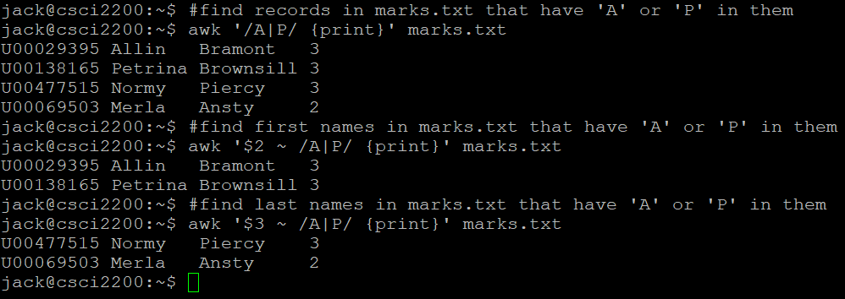
awk - Operators (Regex)
marks.txt

Slide 62
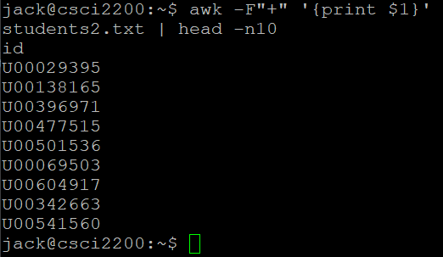
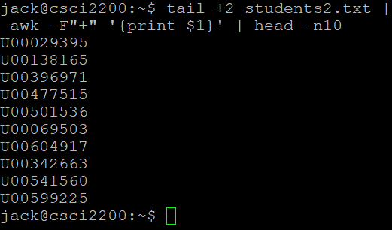
awk - Operators (Regex)
students2.txt
oops
better

Slide 63
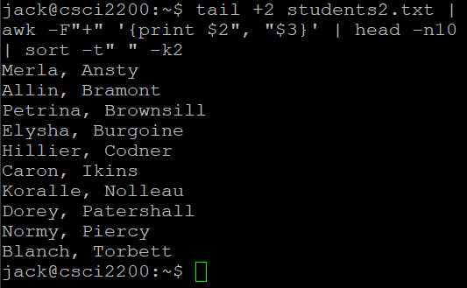
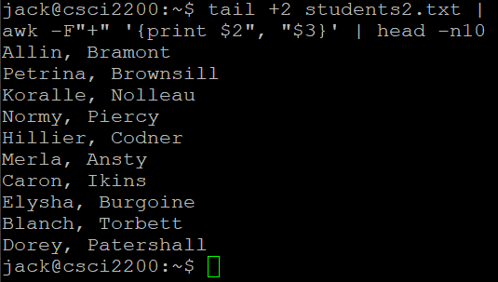
awk - Operators (Regex)
students2.txt
unsorted
sorted - note that we can use awk in pipelines

Slide 64
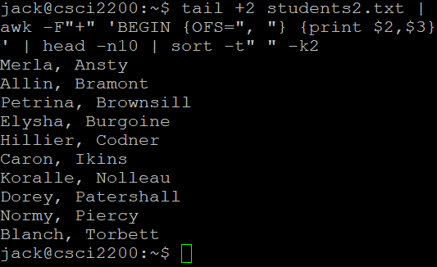
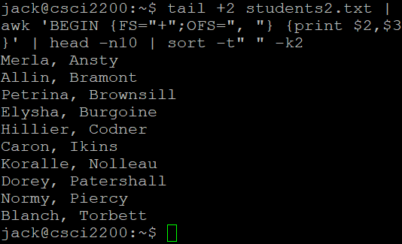
awk - Operators (Regex)
students2.txt
changing OFS (variable declarations have to go in BEGIN)
alternate - declaring FS in BEGIN block

Slide 65
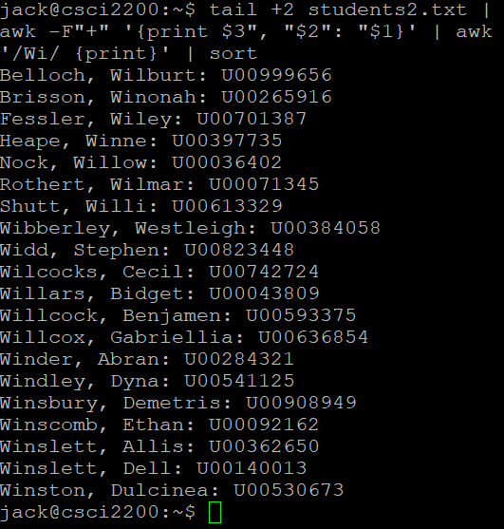
awk - Operators (Regex)
students2.txt
let’s say we want just names that have ‘Wi’ in them…
hmmm…not quite what I was thinking. I meant ‘last names’

Slide 66

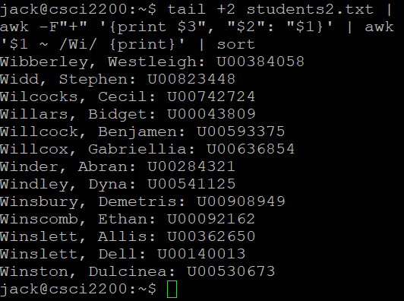
awk - Operators (Regex)
students2.txt
let’s say we want just names that have ‘Wi’ in them…
this tripped me up for a minute…
though ‘last name’ is the third field in the original file, the first awk shifted its position to first ($1)

Slide 67
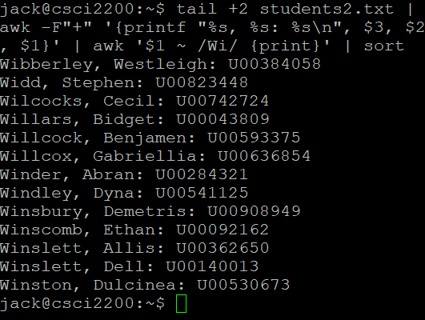
awk - Operators (Regex)
students2.txt
let’s say we want just names that have ‘Wi’ in them…
formatted print … not too exciting, yet

Slide 68
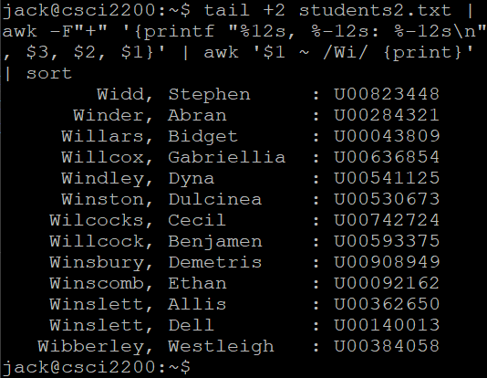
awk - Operators (Regex)
students2.txt
let’s say we want just names that have ‘Wi’ in them…
much better!

Slide 69
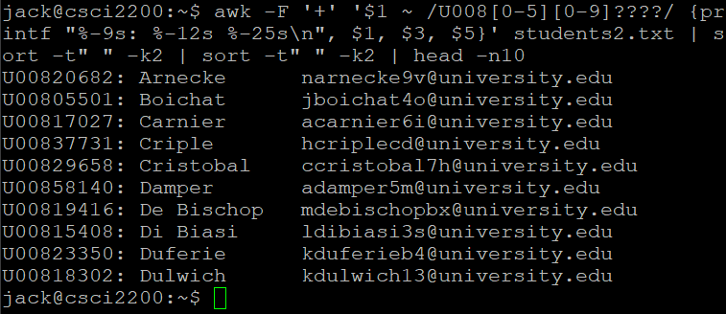
awk - Operators (Regex)
students2.txt
U-num (U008[0-5]xxxx, last name, email (sorted on last name)
note the regex

Slide 70
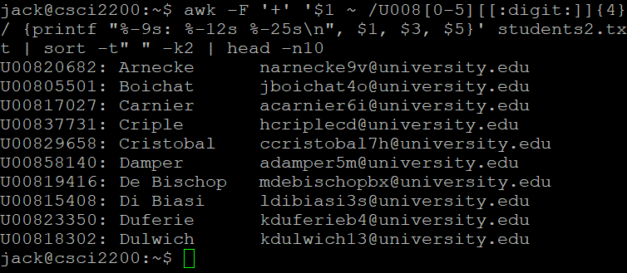
awk - Operators (Regex)
students2.txt
U-num (U008[0-5]xxxx, last name, email (sorted on last name)
note the regex

Slide 71
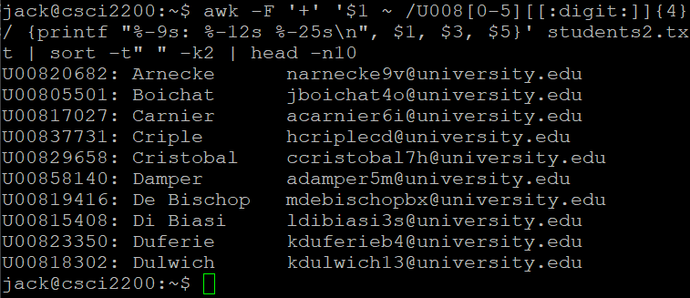
awk - Operators (Regex)
students2.txt
U-num (U008[0-5]xxxx, last name, email (sorted on last name)
note the regex

Slide 72
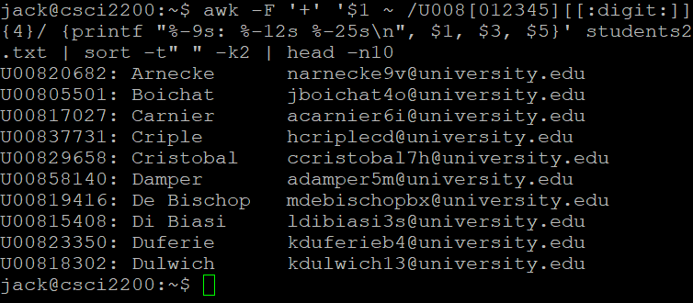
awk - Operators (Regex)
students2.txt
U-num (U008[0-5]xxxx, last name, email (sorted on last name)
note the regex

Slide 73


